Slide 1
Attention!
In order to print this two-page flyer, please follow these steps:
1) Personalize the text and logo area with your custom copy and logo.
2) Delete this page if you don‘t want it printed.
3) Export a PDF file before printing, otherwise embedded images could leave artifacts on the page. Then print from the PDF file.

Slide 2

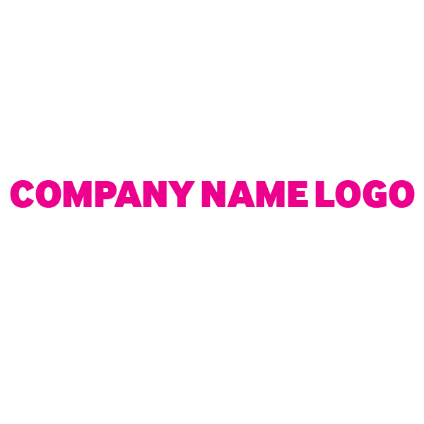
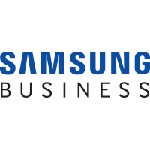

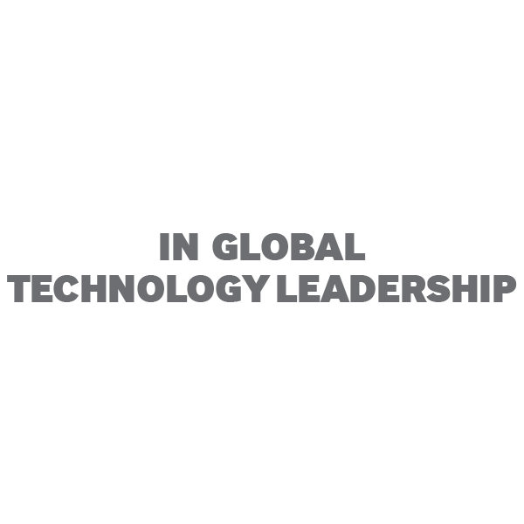
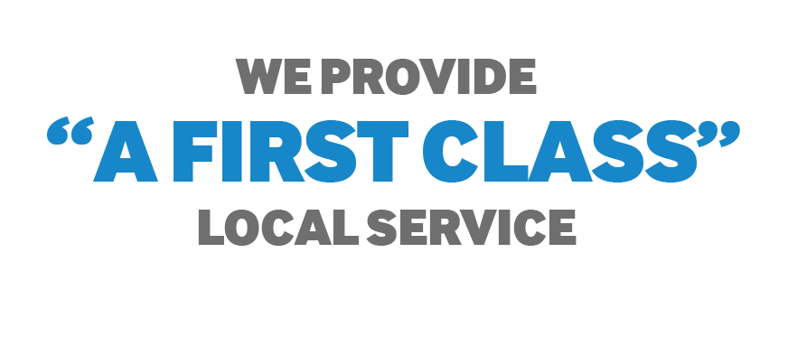





Smarter Business is Built on
Samsung Printing Innovation
Innovative print operations and management
with Samsung and Company Name
No.
1
World’s most sustainable
technology company
(Dow Jones Sustainability Index, 2011)
2
nd
Second-biggest
US patent winner
(IFI, 2013)
7
th
Best global
brand
(Interbrand, 2014)
At Company name, we take the time to understand individual customer requirements to ensure that our customers’ changing needs are at the heart of our business. Our partnership with Samsung ensures we can develop innovative solutions for customers, as well as deliver the best value for money.
As a worldwide leader in semiconductor, telecommunications and digital convergence technologies, Samsung offers a depth of industry-leading expertise in intelligent printing solutions.
Whatever your ambition, outlook or budget, we have a solution to assist you in being more efficient, more productive and more profitable!
Find the right printing solution for your
business size or type
As a global technology leader, Samsung
leverages its broad industry expertise to provide print solutions that support the needs of various types of clients.
Empower the workforce with increased
productivity
We help you save time and boost productivity with improved workflows through document digitalization.
Save on printing like never before
Our printing solutions are not just cost-effective and reliable hardware; they can help you improve operational efficiency and business productivity with advanced features such as fleet management and document distribution.
Safeguard important information with
innovative tools
We integrate Samsung printing solutions to help protect your valuable information and prevent security compliance issues.

Slide 3



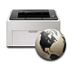
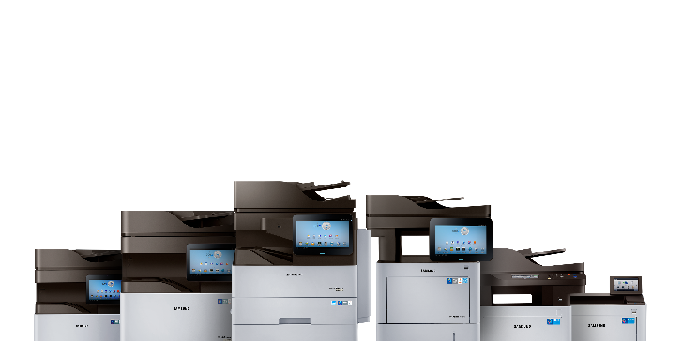

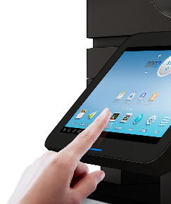
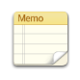

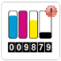








Drive Your Business Forward
With Samsung and Company Name
Our core values help drive your business forward into the next smart workplace
The market is changing
Priorities have shifted to mobile computing, ease-of-use and cloud connectivity; worldwide revenue for paper-to-digital solutions is expected to increase significantly. Security is also a concern, as most employee mobile devices are connected to corporate networks and almost all enterprises employ a cloud storage solution.
Smart, complete printer lineup
backed by the latest technology
The next printing solutions
that revolutionize the way you work
We offer a range of innovative hardware choices from A4 to A3 MFPs that deliver fast performance, professional-quality output, ease-of-use and secure performance.
Not only providing various printing solutions, Samsung has also developed the intuitive, Android™-based Smart UX Center, which we believe will revolutionize the way enterprises use and manage their printers.
Convergence offering
that enables your mobile workforce
Unsurpassed reliability and support
keep your business working
Samsung is the only company that has both the complete IT ecosystem and the industry-leading mobile solution technology in which your employees are mobile, untethered to their desktop, and able to create, view, share and print information at any time from anywhere.
We all know anything that helps our business run more smoothly is priceless, especially when it comes to device management. Backed by reliable performance and available whenever and wherever you need it,
we will always respond to your query.
Contact us to smartify your business!
If you’re interested in talking to us about a new solution for your organization or have a question about any of our services
you can reach us using one of the ways below.
partner@email.com
0000-000-0000
0000-000-0000
XXXXXX,
XXXXXXXX XXXXX, XXXXX

